Slide 1
Alice 3 Workshop Arrays
Copyright 2015 Wanda Dann, Don Slater

Slide 2
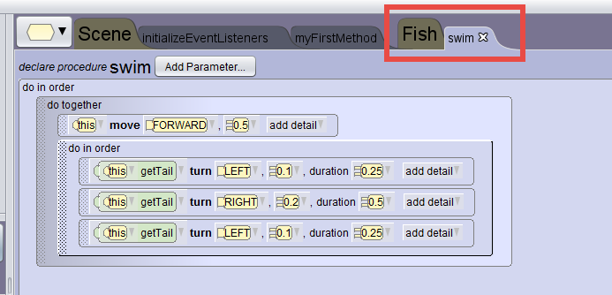
Where we are
We have defined a swim procedure for the Fish class.
Notes:
If someone has a problem with their world, can start this session with Yet-SharksVariables.a3p world in the Day 4 Worlds folder

Slide 3
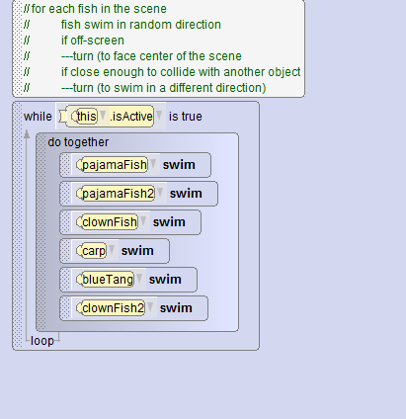
Where we are
A while loop is used to call the swim procedure for each fish in the Scene’s myFirstMethod
What if we had a school of dozens of fish?
Notes:
If someone has a problem with their world, can start this session with Yet-SharksVariables.a3p world in the Day 4 Worlds folder

Slide 4
Organizing structure
When multiple objects have the same joint structure and the same behavior, we can organize the objects in a data structure.
The organizing structure in Alice is an array.
Pros:
Allows code to be written once, for all objects in the structure.
Abstracts the concept of a group or set of objects
Cons:
More challenging syntax and operations

Slide 5
Pros & Cons
Array
Pros:
Allows code to be written once, for all objects in the structure.
Abstracts the concept of a group or set of objects
Cons:
More challenging syntax and operations in the code

Slide 6
Array
A traditional CS definition of an array:
A set of items (objects, numbers, etc.) in an ordered arrangement, often depicted in a row or column.
The items in an array must be of the same data type.
An array of whole numbers
An array of shoes

Slide 7
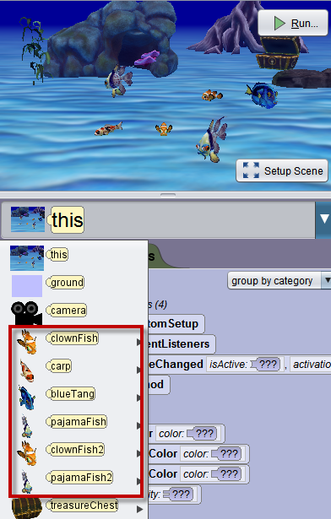
In this example
Can we make an array of the fish in this example?
Consider: the fish in this scene are instances of different classes
ClownFish
Carp
BlueTang
PajamaFish

Slide 8
Recall: Class hierarchy
The ClownFish, Carp, BlueTang, and PajamaFish classes are child-classes of the Fish class
So, we can create an array of Fish objects

Slide 9
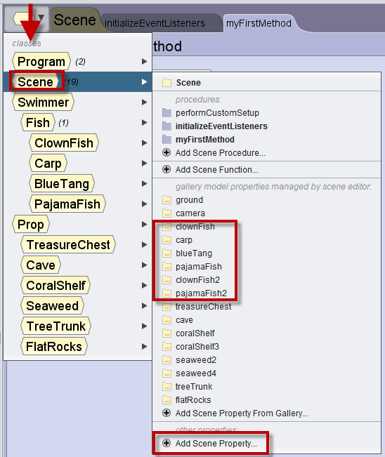
A property of the Scene class
The fish are all objects in a scene.
Create an array of fish as a property in the Scene class.

Slide 10
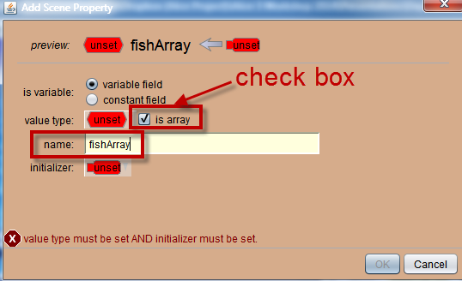
Creating an array
Check the is array box
Enter a name for the array

Slide 11
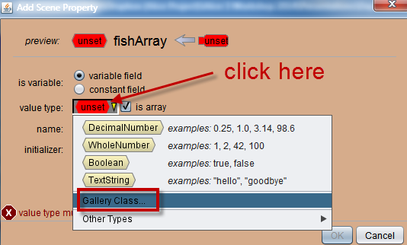
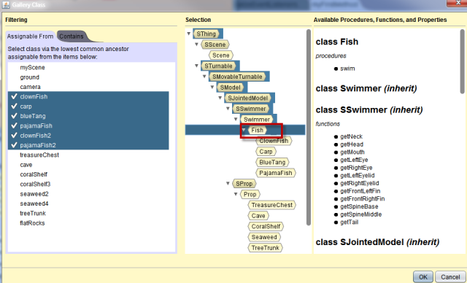
Select type

Slide 12
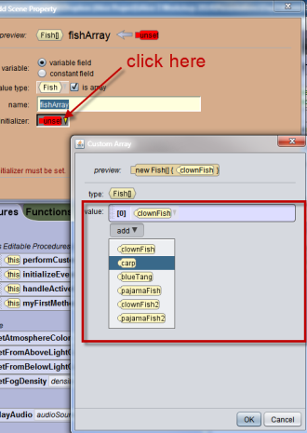
Initialize array
Add each individual fish object to the array.

Slide 13
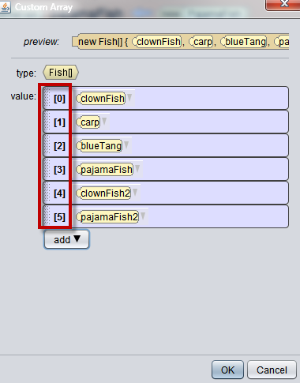
Ordering
Items in an array are ordered, starting at the beginning and successively numbered to the end of the array.
Numbering begins at 0.

Slide 14
Index
The number of an item in the array is its index.
In this example,
Fish[0] is the clownFish
Fish[2] is the blueTang

Slide 15
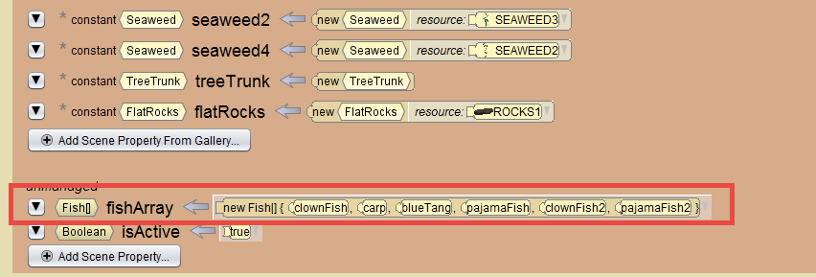
Scene Class
The array declaration is now listed in the Scene Class.
Fish[] indicates an array of Fish objects

Slide 16
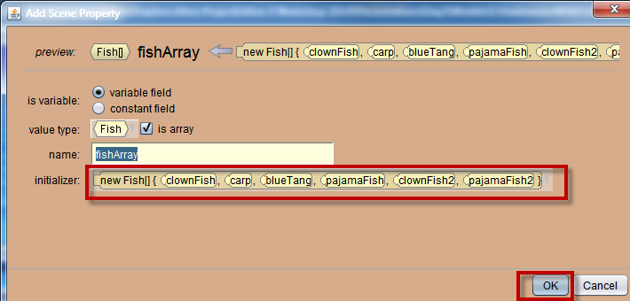
Access
Access means to set or get an object or value
To access a specific object in an array, use the array name and an index.
fishArray[0]
fishArray[1]
fishArray[2]

Slide 17
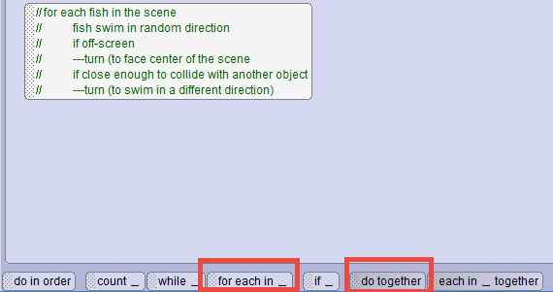
Using an array – Control tiles
Two array control tiles
We want to replace a do together, so use each in _together

Slide 18
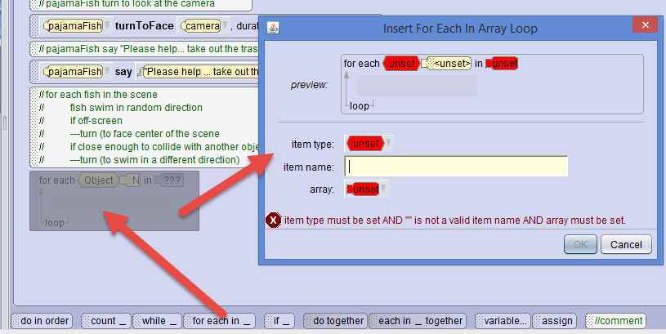
Drag in the tile

Slide 19
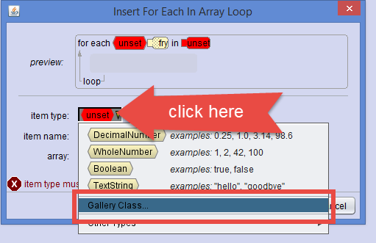
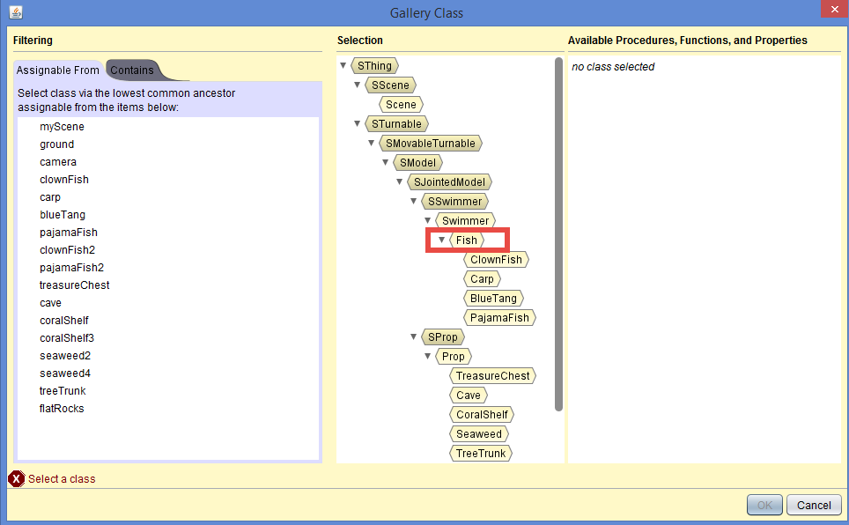
Select item type

Slide 20
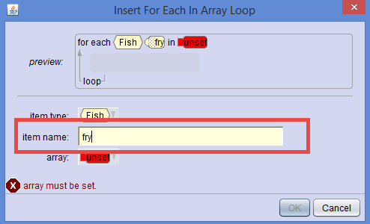
Enter a name
Can use a name that would refer to any item in the array. For example, fry is a commonly used name for any small fish

Slide 21
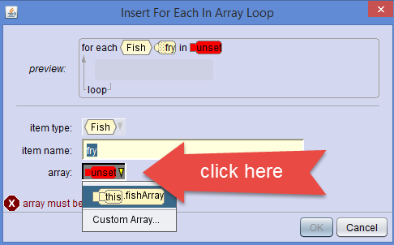
Select array
Select this.fishArray (“this” is “this scene”)

Slide 22
Result
Each fry (of type Fish) in fishArray will perform the action in the code block

Slide 23
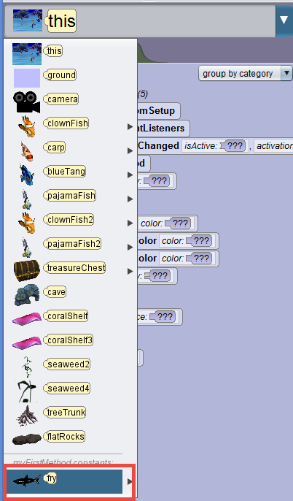
Select fry
fry is a placeholder… represents any item in the array

Slide 24
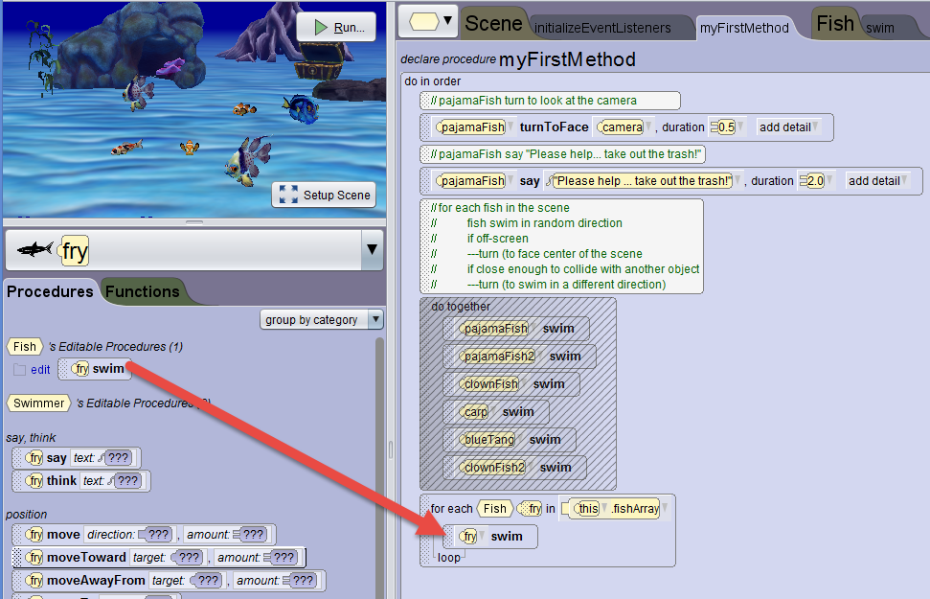
Create code in the block
Drag in the fry’s swim procedure tile
Notes:
Although begin and end abruptly may at first seem counter intuitive, when you consider the action relative to the loop’s timing, it makes sense that it “smooths” the motion

Slide 25
Test
Does it work?

Slide 26
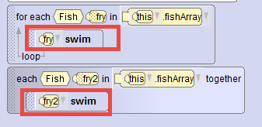
Your turn
Create a second code block using the
each_in together
Note: Different placeholder names must be used in the code blocks

Slide 27
Test

